Slide 1
Humerus shaft

Slide 2
Incidence
3-5% of all fractures
Bimodal age distribution
young patients: high-energy trauma
elderly, osteopenic patients: low-energy injuries

Slide 3
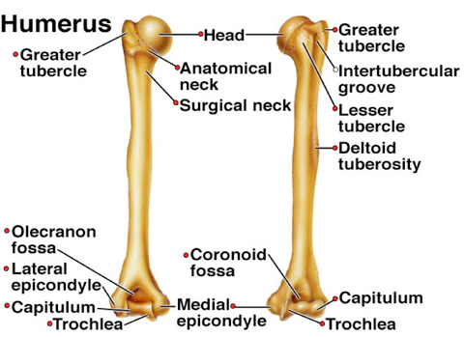
Diagram

Slide 4
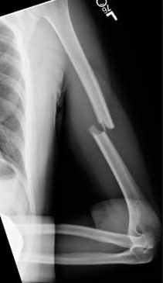
Image

Slide 5
Important relation
Radial nerve
courses along spiral groove
14cm proximal to the lateral epicondyle
20cm proximal to the medial epicondyle

Slide 6
Classes
Classification
OTA bone number: 1 fracture location: 2 fracture pattern: simple: A, wedge: B, complex: C Descriptive fracture location: proximal, middle or distal third fracture pattern: spiral, transverse, comminuted Holstein-Lewis fracture a spiral fracture of the distal one-third of the humeral shaft commonly associated with neuropraxia of the radial nerve (22% incidence)

Slide 7
Clinical features
Symptoms
pain
extremity weakness
Physical exam
examine overall limb alignment
preoperative or pre-reduction neurovascular exam is critical
examine and document status of radial nerve pre and post-reduction

Slide 8
Radiographic views
AP and lateral
include joint above and below the injury
transthoracic lateral
may give better appreciation of sagittal plane deformity
traction views
may be necessary for fractures with significant shortening, proximal or distal extension but not routinely indicated

Slide 9
Nonoperative treatment
Coaptation splint followed by functional brace
indicated in vast majority of humeral shaft fractures
criteria for acceptable alignment include:
< 20° anterior angulation
< 30° varus/valgus angulation
< 3 cm shortening
absolute contraindications
severe soft tissue injury or bone loss
vascular injury requiring repair
brachial plexus injury
radial nerve palsy is NOT a contraindication to functional bracing
outcomes
90% union rate
increased risk with proximal third oblique or spiral fracture
varus angulation is common but rarely has functional or cosmetic problems

Slide 10
Operative
absolute indications
open fracture
vascular injury requiring repair
brachial plexus injury
ipsilateral forearm fracture (floating elbow)
compartment syndrome

Slide 11
Operative
Plates and screws
IM nails

Slide 12
Coaptation Splint & Functional Bracing
Coaptation splint
applied until swelling resolves
adequately splint extends up to axilla and over shoulder
common deformities include varus and extension
Mold accordingly to counter displacement
Functional bracing
extends from 2.5 cm distal to axilla to 2.5 cm proximal to humeral condyles
sling should not be used to allow for gravity-assisted fracture reduction
shoulder extension used for more proximal fractures

Slide 13
Complications
Radial nerve palsy
seen in 8-15% of closed fractures
increased incidence distal one-third fractures
neuropraxia most common injury in closed fractures and neurotomesis in open fractures
85-90% of improve with observation over 3 months
spontaneous recovery found at an average of 7 weeks, with full recovery at an average of 6 months

Slide 14
Treatment of radial nerve palsy
observation
initial treatment in closed humerus fractures
obtain EMG at 3-4 months
wrist extension in radial deviation is expected to be regained first
brachioradialis first to recover, extensor indicis is the last
surgical exploration
indications
open fracture with radial nerve palsy (likely neurotomesis injury to the radial nerve)
closed fracture that fails to improve over ~ 3-6 months
fibrillations (denervation) seen at 3-4 months on EMG

Slide 15
Other complications
Malunion
Non union
Infection

